Slide 1

MAZE RUNNER

Slide 2
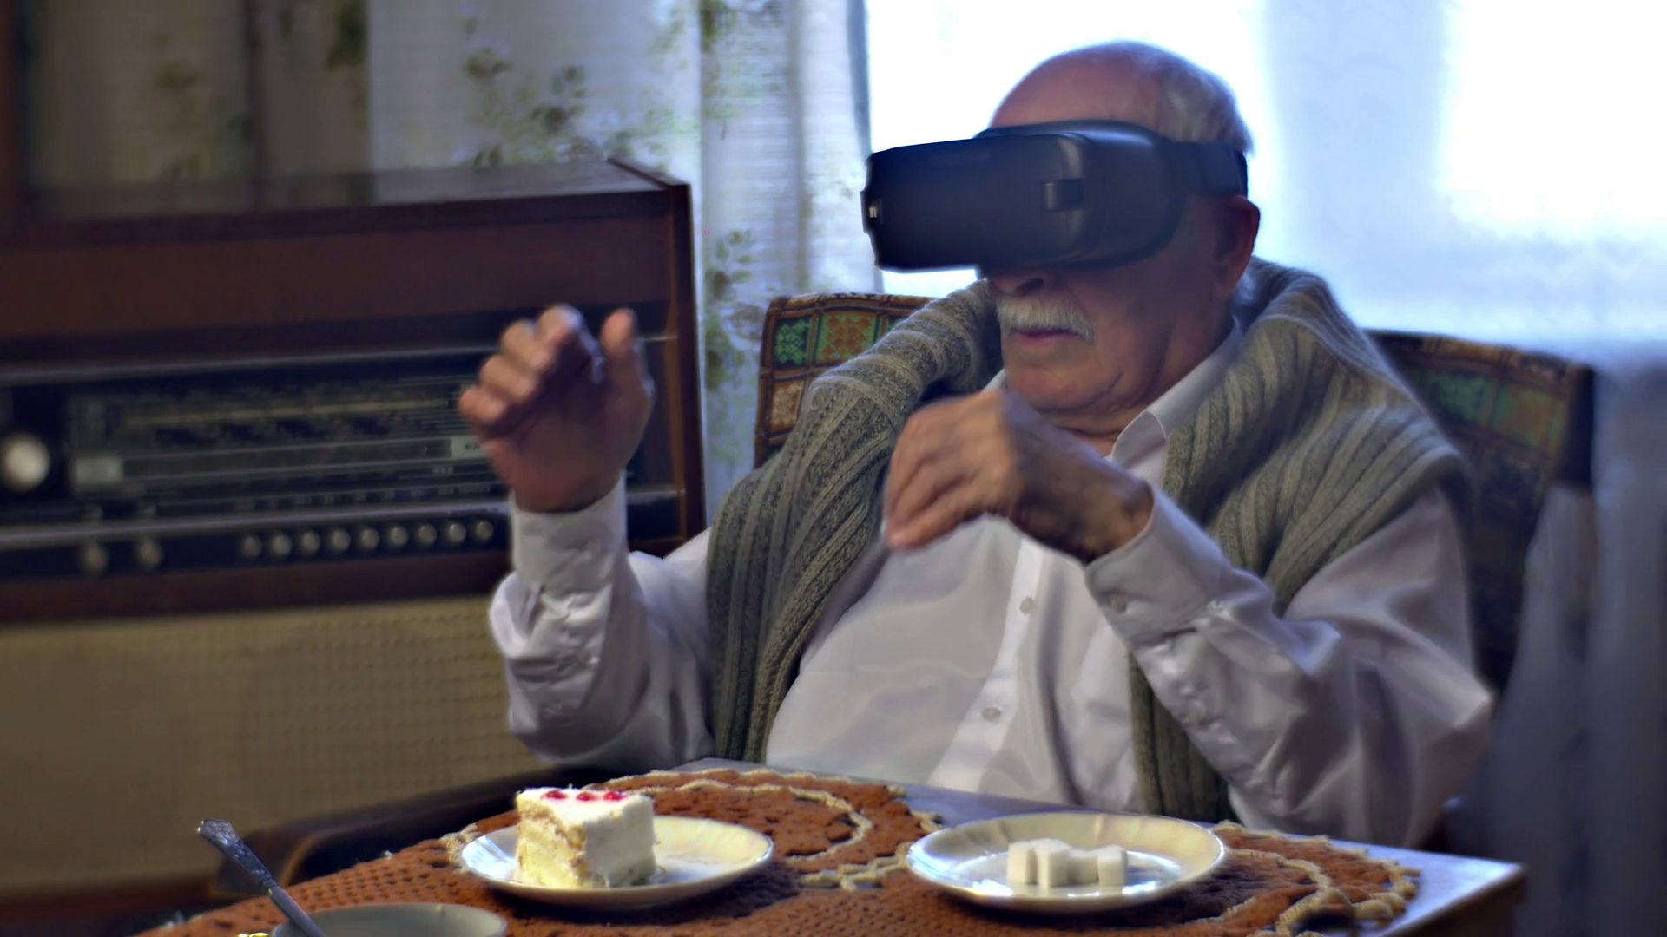
Virtual Reality, A New Frontier

Slide 3
Meet the Team
IT Manager: Jacob
Software Architect: Cameron
Quality Assurance Manager: Conrad
Project Manager: Benjamin
Coding Standards: Delaney
Documentation Specialist: Corbin

Slide 4
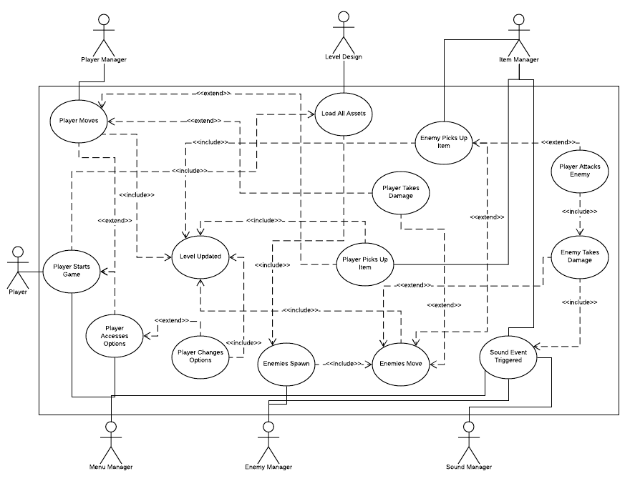
Global Use Case

Slide 5
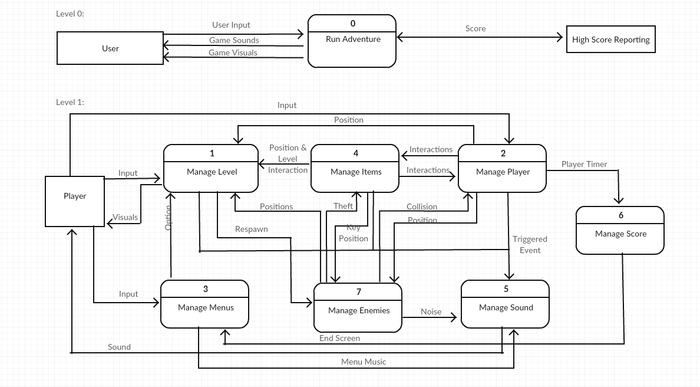
Context Diagram

Slide 6
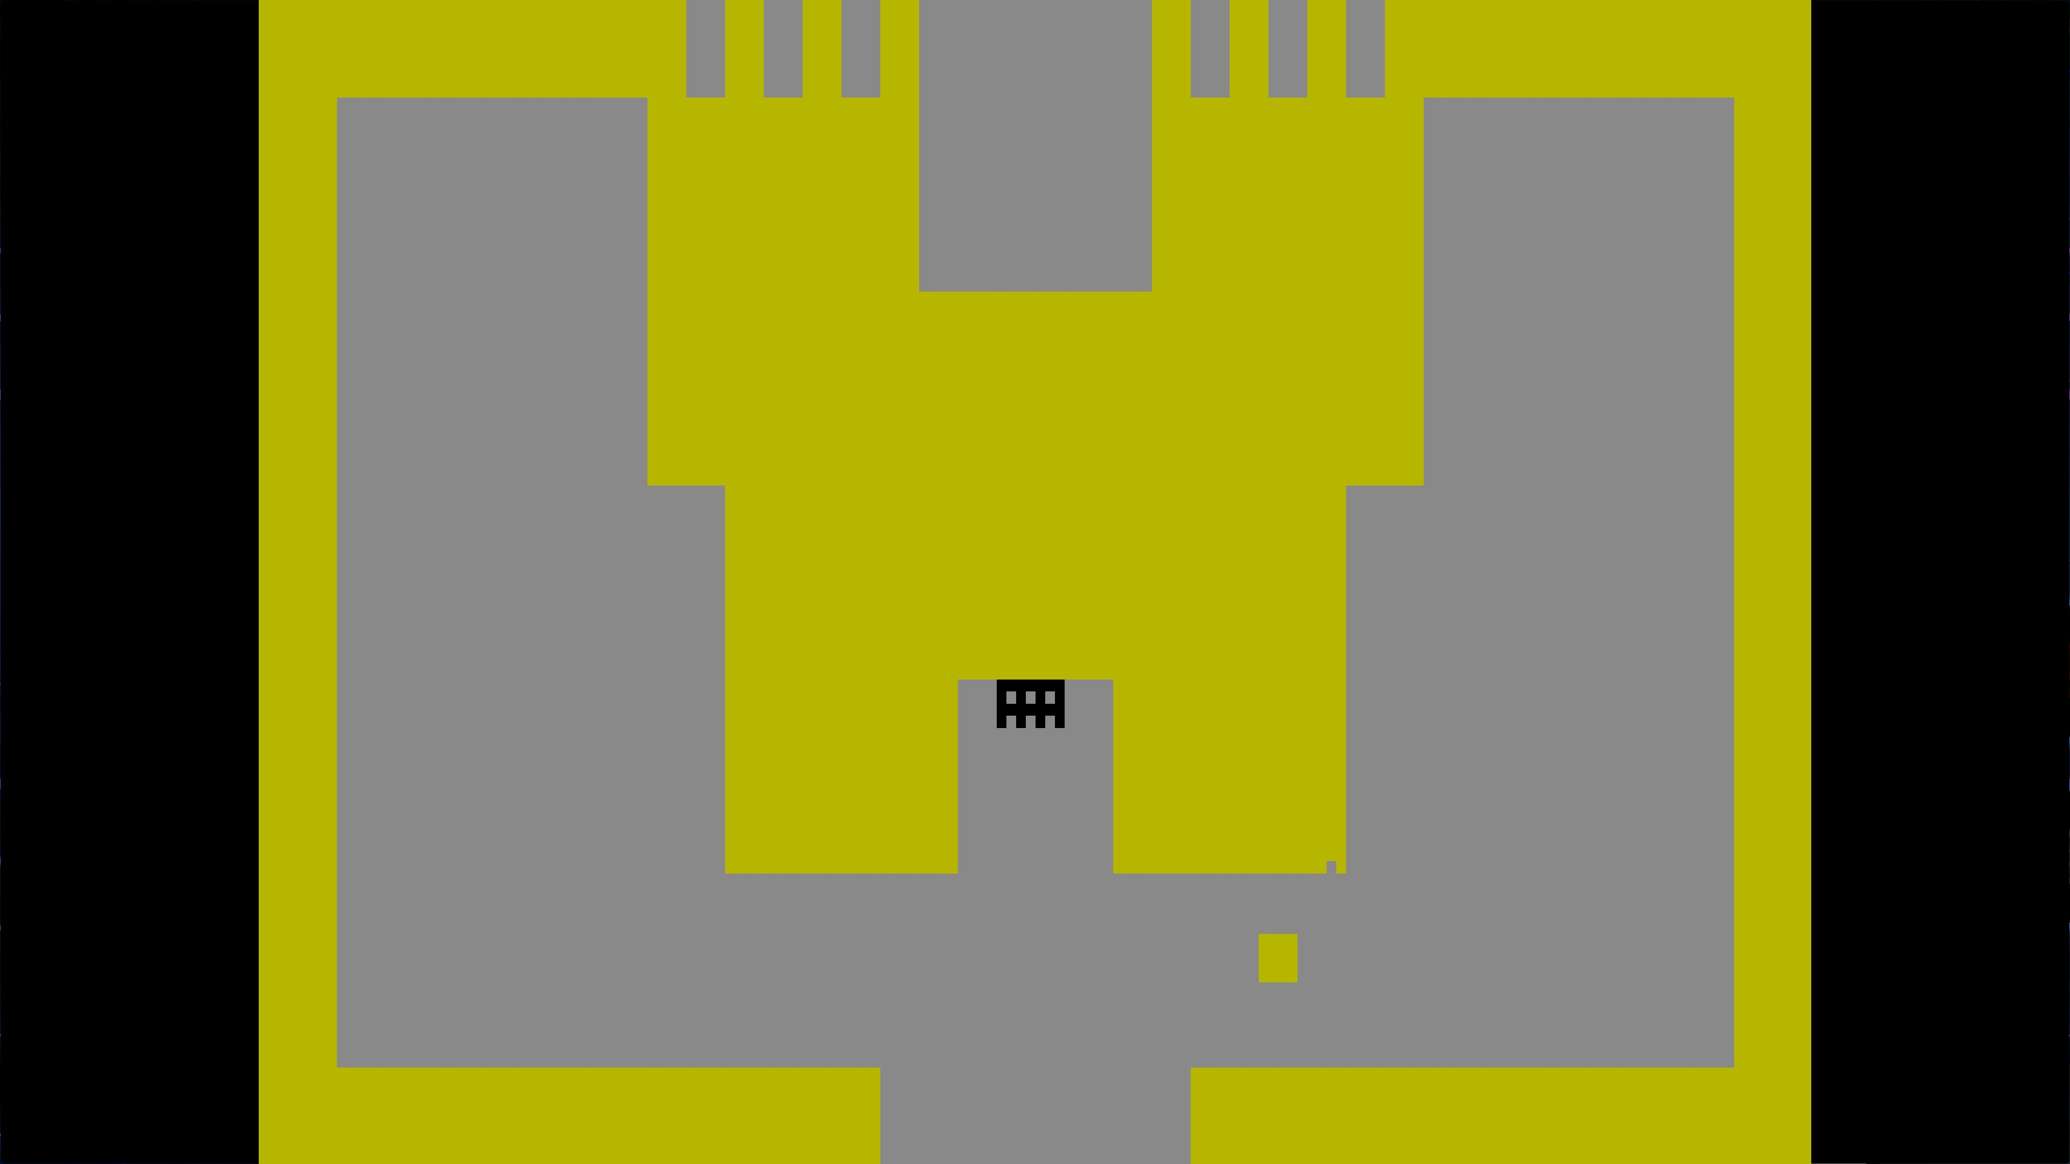
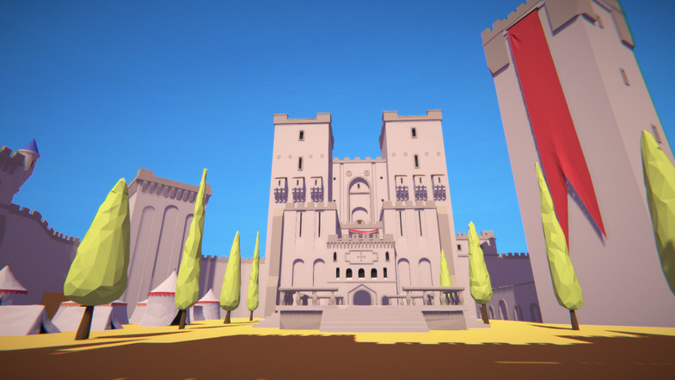
Sample Screenshots

Slide 7
Project breakdown Diagram
Team Member | Subsystem
Jacob | Level Management
Ben | Player Management
Cameron | Menu Management
Cameron | Sound Management
Corbin | Enemy Management
Delaney | Item Management
Conrad | Score Management

Slide 8
Level Management
Priority Level: 1
Role:
Load all game assets properly into the world
Player
Items
Enemies
World assets
Bounds check all game assets
Raise collision flags on player collision with map assets
Swap scenes

Slide 9
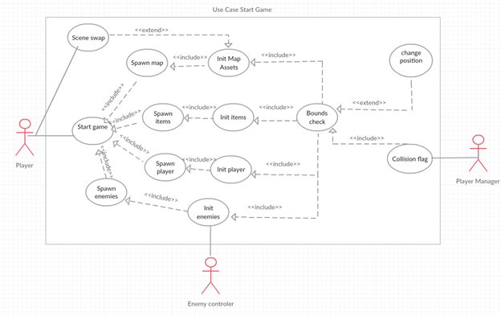
Level Management

Slide 10
Level Management
Task​ | Duration (PHks)​ | Predecessor Task(s)​
1. Obtain 3D assets | 5 | -​
2. Implement World loading | 3 | 1​
3. Implement Item/Player/Enemy loading | 10 | 2​
4. Implement Bounds Check​ | 15 | 3​
5. Implement Player manager Collision Check​ | 2 | 3​
6. Implement scene swapper | 1 | 2
7. Testing | 5 | 1,2,3,4,5,6
8. Installation | 1 | 7

Slide 11
Level Management
Questions?

Slide 12
Player Management
Priority Level: 1
Role:
To receive direct input from the user to streamline the process
Responsible for moving the player and checking its possible updated position using collision checks
Ensuring the player’s movements are smooth, they cannot travel out of bounds, and that collision detection works

Slide 13
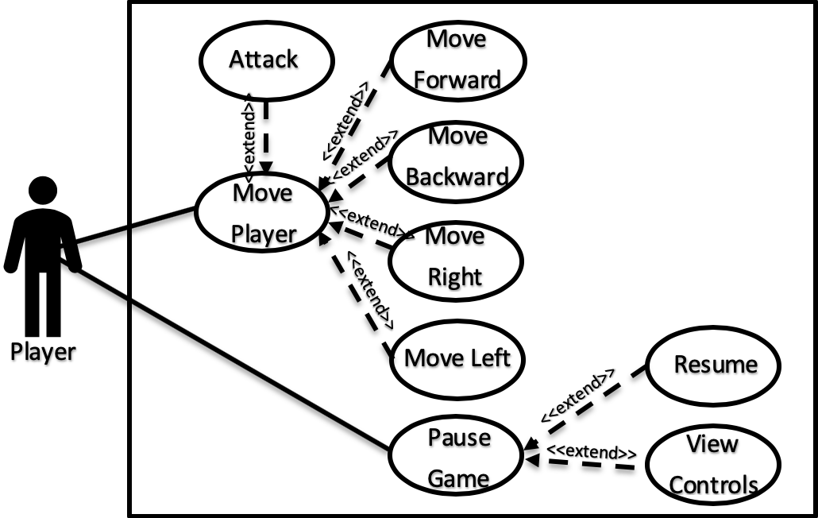
Player Management

Slide 14
Player Management
Task | Duration (PWks) | Predecessor Task(s)
1. Requirements Collection | 1 | -
2. Implement Manage Player Controls | 2 | 1
3. Implement Update Player Position | 2 | 2
4. Implement Collision Check | 2 | 3
5. Implement Item Collision Check | 1 | 3
6. Testing | 2 | 5
7. Installation | 1 | 6

Slide 15
Player Management
Questions?

Slide 16
Enemy Management
Priority Level: 2
Role:
Control the spawning and despawning of enemies in the game
Keep track of all enemies' stats such as health, damage, is spawned... etc
Manage the movement of each enemy in the game
Manage the interactions between enemies and certain items in the game
Manage combat between enemies and the player
Fairly complex compared to most other features

Slide 17
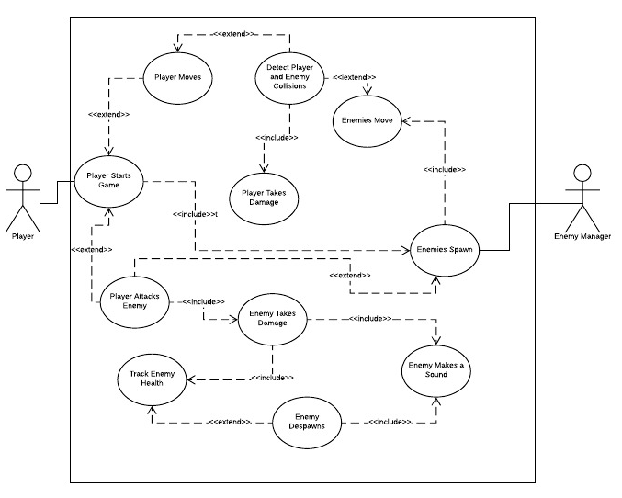
Enemy Management

Slide 18
Enemy Management
Task​ | Duration (PWks)​ | Predecessor Task(s)​
1. Requirements Collection​ | 1​ | -​
2. Prototype Design​ | 1​ | 1​
3. Enemy Spawning​ | 1​ | 2​
4. Enemy Movement​ | 3​ | 3​
5. Enemy Item Interactions​ | 2​ | 4​
6. Enemy Combat System​ | 2​ | 4​
7. Testing​ ​ | 3​ | 5,6​

Slide 19
Enemy Management
Questions?

Slide 20
Item Management
Priority: 2
Role:
Control item placement and interactions
Chalice
Key
Sword
Manage user-item/enemy-item/map-item interactions
Pick up item
Drop item
Use item (unlock door, attack enemy)

Slide 21
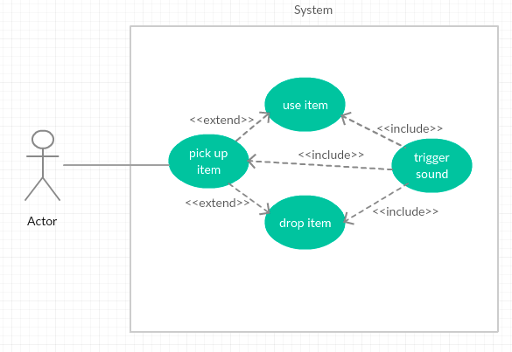
Item Management

Slide 22
Item Management
Task​​ | Duration (PWks)​​ | Predecessor Task(s)​​
1. Requirements Collection​​ | 3 | -​​
2. ​​Function Definitions | 2 | 1​​
3. ​​User Documentation | 1 | 1
4. Programming | 3​​ | 2,3​​
5. Testing | 2​​ | 4​​
6. Installation | 2​​ | 5​​

Slide 23
Item Management
Questions?

Slide 24
Menu Management
Priority Level: 3
Role of the Menu:
Take user input and translate that into something the game can use
Create a customizable/unique user experience

Slide 25
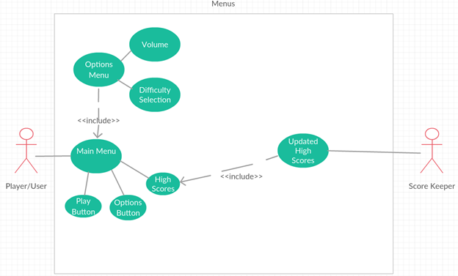
Menu Management

Slide 26
Menu Management
Task | Duration (PHrs) | Predecessor Task(s)
1. Define Settings | 1 | -
2. Menu Layout | 1 | 1
3. Create Main Menu | 5 | 1,2
4. Create Scene Switcher | 1 | 3
5. Create Buttons | 6 | 3
6. Create Options Menu | 1 | 3
7. Testing | 6 | 3,6
8. Installation | 8 | 7

Slide 27
Menu Management
Questions?

Slide 28


Sound Management
Role: Provide auditory sensory to player to construct a more powerful Virtual Reality Experience
Priority: 3
no other systems depend on this mechanism, but we value it as an essential feature

Slide 29
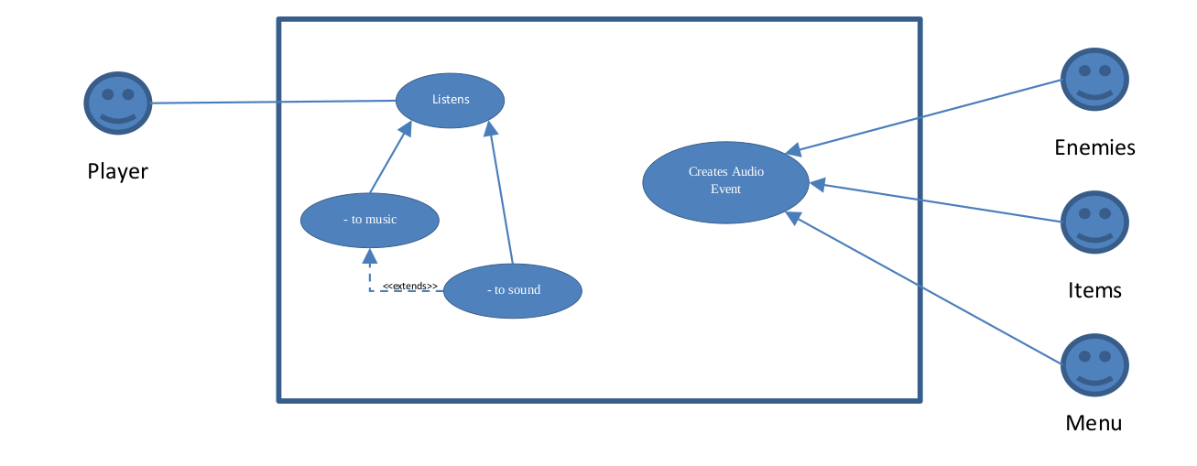
Sound Management
Sounds and Music rely on a Trigger Event

Slide 30
Sound Management
Task | Duration (P. Days) | Predecessor Task(s)
1. Event Decoding | 1 | 5
2. Sound Control | 1 | -
3. Music Control | 1 | 2
4. Testing | 2 | 1, 3
5. Asset Collection | 2 | -
6. Final Merge | 1 | 4

Slide 31
Sound Management
Questions?

Slide 32
Overall Questions?

